Slide 1
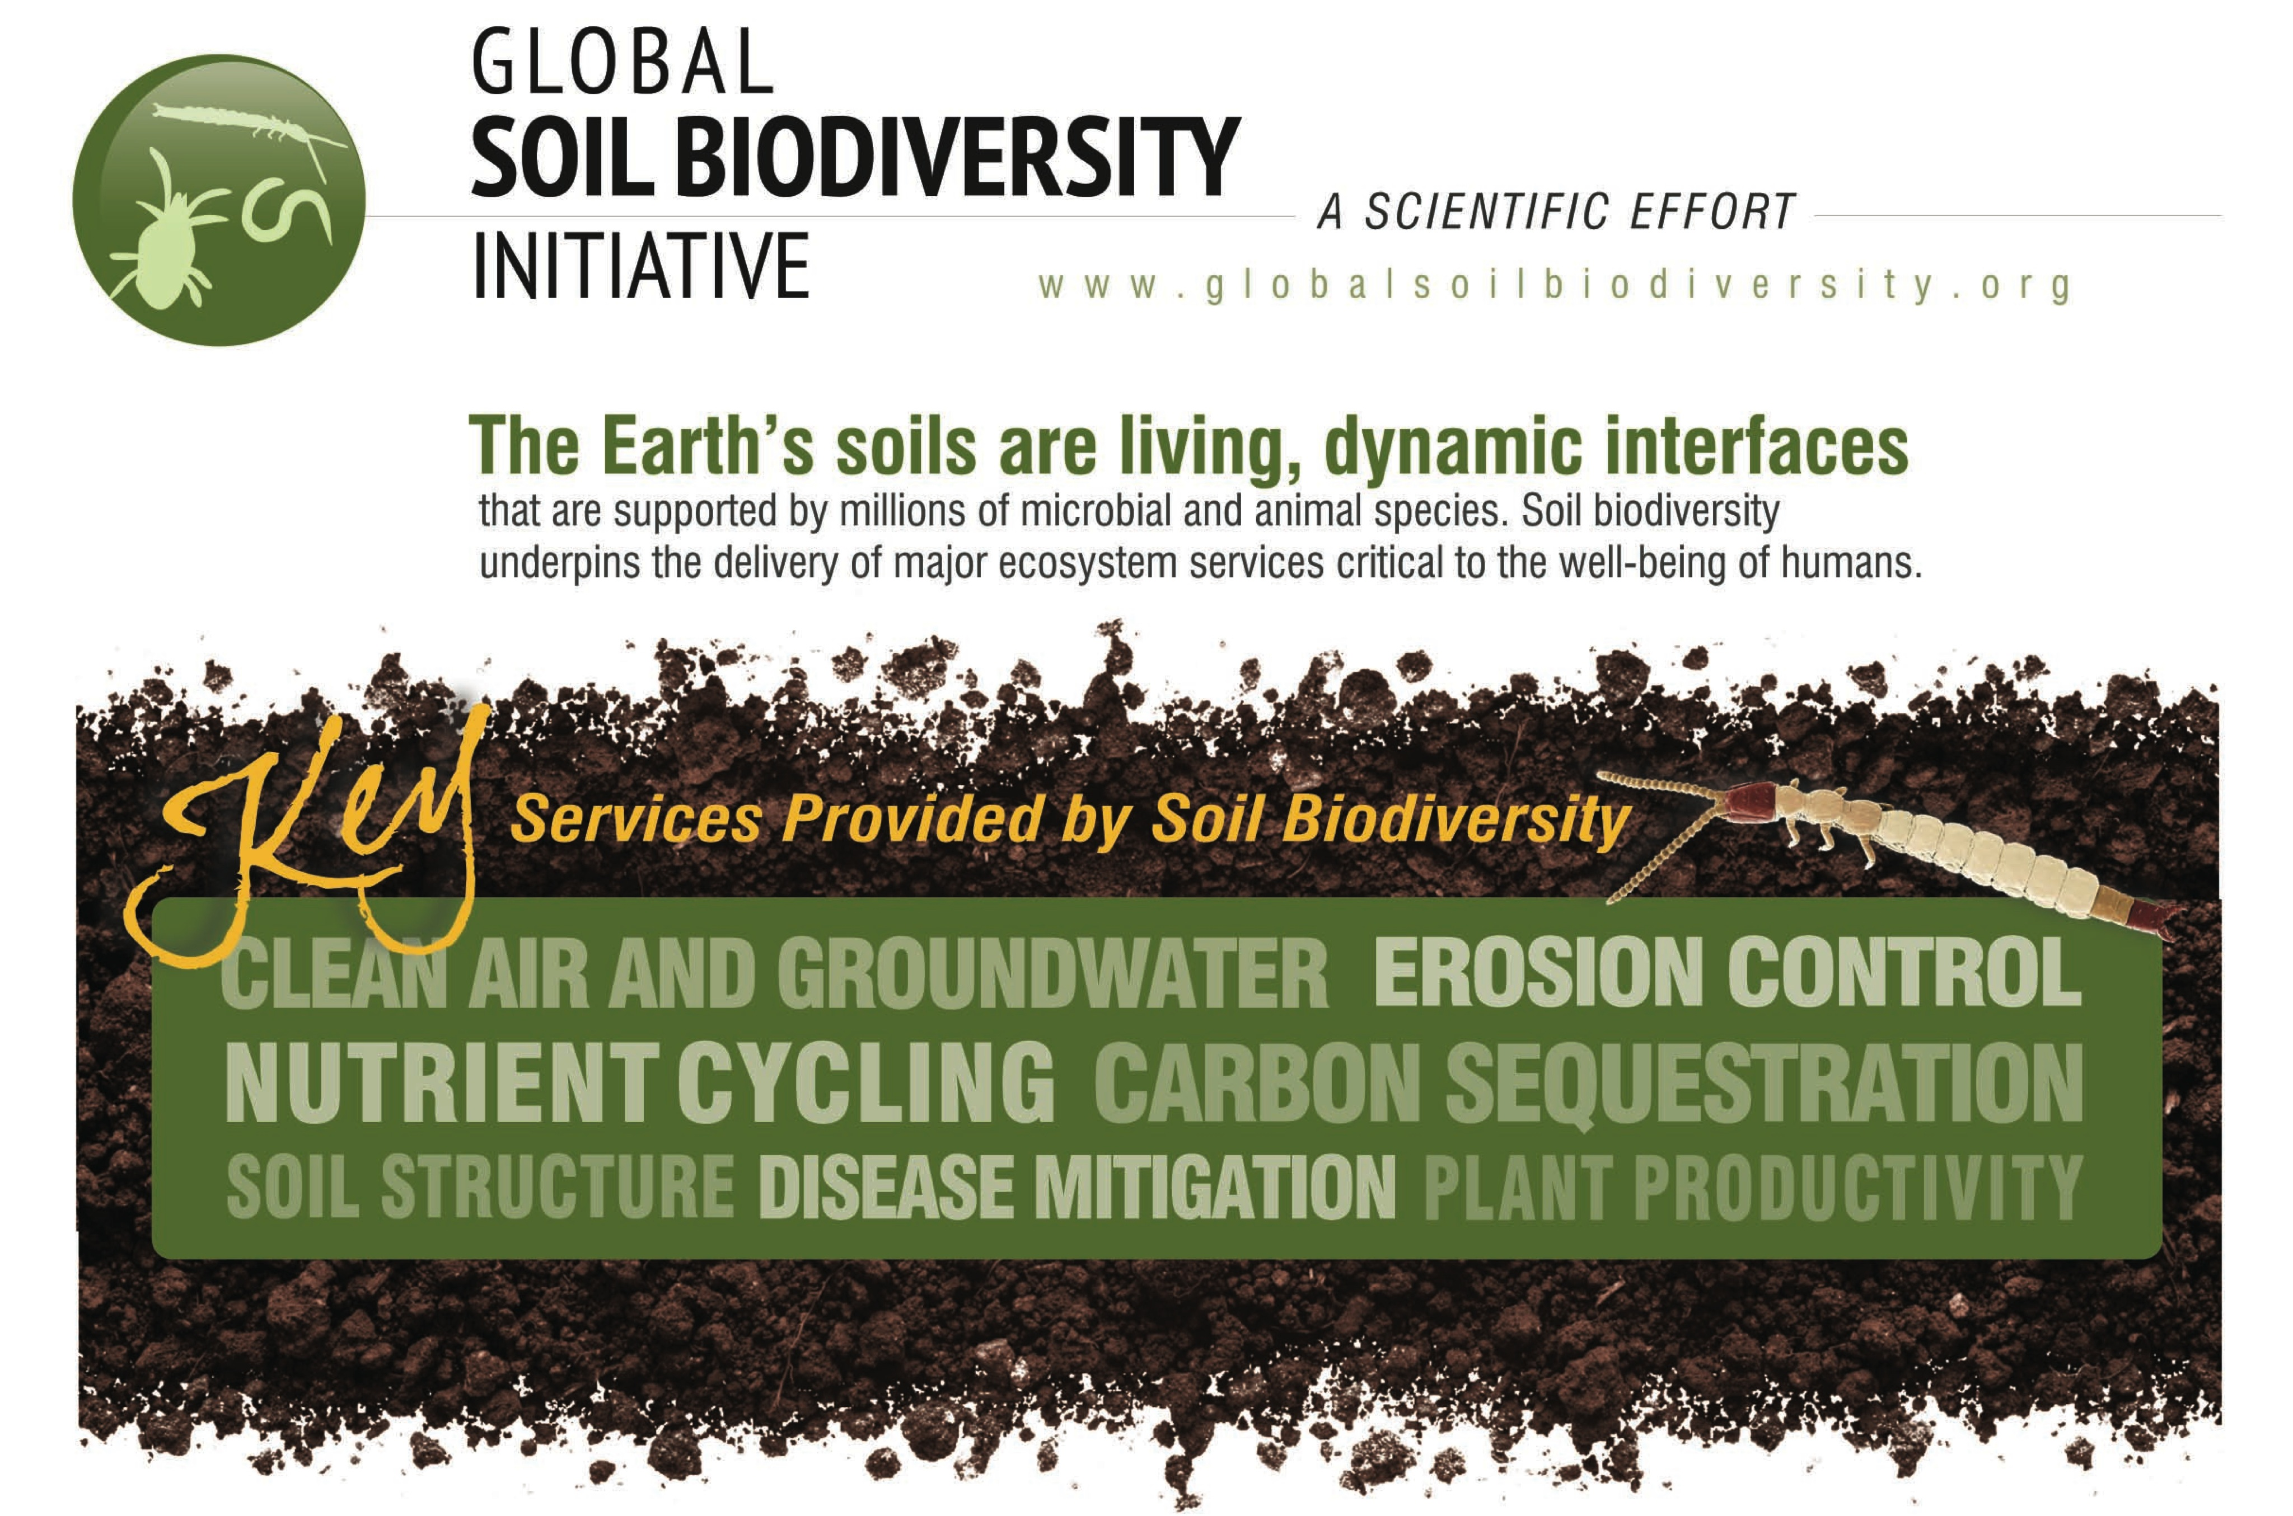
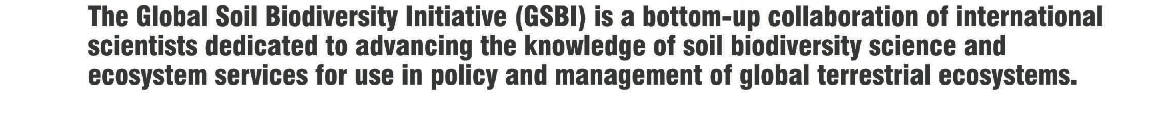

Slide 2




@theGSBI

Slide 3
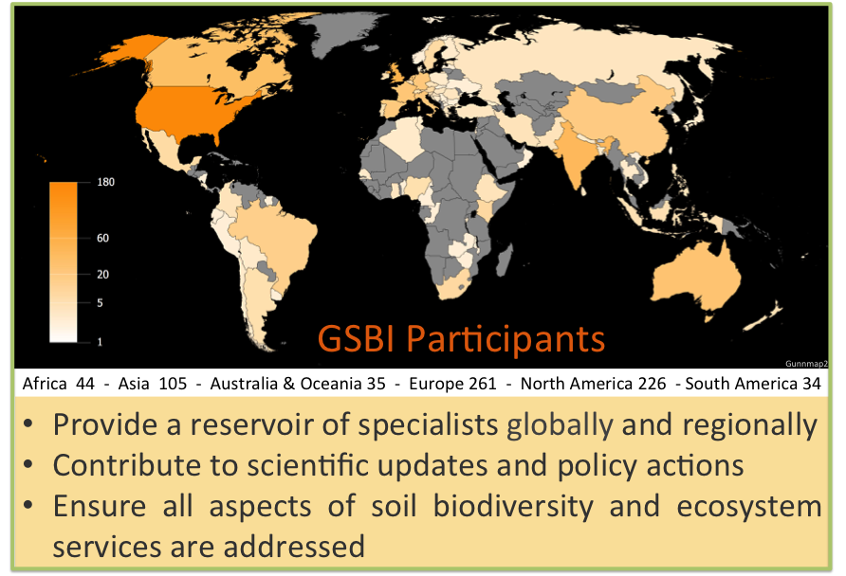

Participation

Slide 4



The Atlas will present current scientific knowledge in a format accessible to the general public, policy makers and scientists.

